Slide 1
Speech Communities
Charalambos Themistocleous

Slide 2
Variation → Language Change

Slide 3
Spreading Change
Sociolinguistics is the study of language use within or among groups of speakers (Wardhaugh, 2002: 116).

Slide 4
A group must have at least two members but there is really no upper limit to group membership.
People can group together for one or more reasons: social, religious, political, cultural, familial, vocational, avocational, etc.
The group may be temporary or quasi-permanent and the purposes of its members may change, i.e., its raison d’être.
A group is also more than its members for they may come and go.
They may also belong to other groups and may or may not meet face-to-face.

Slide 5
The organization of the group may be tight or loose
the importance of group membership is likely to vary among individuals within the group, being extremely important to some and of little consequence to others.

Slide 6
An individual’s feelings of identity are closely related to that person’s feelings about groups in which he or she is a member, feels strong (or weak) commitment (or rejection), and finds some kind of success (or failure).

Slide 7
What does Wardhaugh (2002:117) mean by saying this:
“Consequently, we must be careful in drawing conclusions about individuals on the basis of observations we make about groups.
To say of a member of such a group that he or she will always exhibit a certain characteristic behaviour is to offer a stereotype.”

Slide 8
Sociolinguists study “Speech Communities”

Slide 9
Linguistic theory is concerned primarily with an ideal speaker–listener, in a completely homogeneous speech-community, who knows its language perfectly and is unaffected by such grammatically irrelevant conditions as memory limitations, distractions, shifts of attention and interest, and errors (random or characteristic) in applying his knowledge of the language in actual performance.
This seems to me to have been the position of the founders of modern general linguistics, and no cogent reason for modifying it has been offered.
To study actual linguistic performance, we must consider the interaction of a variety of factors, of which the underlying competence of the speaker–hearer is only one.
In this respect, study of language is no different from empirical investigation of other complex phenomena. Noam Chomsky (1965, 3-4).

Slide 10
Lyons (1970, p. 326) offers a definition of what he calls a ‘real’ speech community: ‘all the people who use a given language (or dialect).’

Slide 11
What we can be sure of is that speakers do use linguistic characteristics to achieve group identity with, and group differentiation from, other speakers, but they use other characteristics as well: social, cultural, political and ethnic, to name a few.

Slide 12
speech markers
Referring to what they call speech markers, Giles, Scherer, and Taylor (1979, p. 351) say:
through speech markers functionally important social categorizations are discriminated, and . . . these have important implications for social organization. For humans, speech markers have clear parallels . . . it is evident that social categories of age, sex, ethnicity, social class, and situation can be clearly marked on the basis of speech, and that such categorization is fundamental to social organization even though many of the categories are also easily discriminated on other bases.
Our search must be for criteria other than, or at least in addition to, linguistic criteria if we are to gain a useful understanding of ‘speech community.’

Slide 13
Labov’s deﬁnition of speech community (1972b, pp. 120–1):
The speech community is not defined by any marked agreement in the use of language elements, so much as by participation in a set of shared norms; these norms may be observed in overt types of evaluative behavior, and by the uniformity of abstract patterns of variation which are invariant in respect to particular levels of usage.

Slide 14
Very Important!!!
Milroy (1987a, p. 13) has indicated some consequences of such a view:
Thus, all New York speakers from the highest to lowest status are said to constitute a single speech community because, for example, they agree in viewing presence of post vocalic [r] as prestigious. They also agree on the social value of a large number of other linguistic elements.
Southern British English speakers cannot be said to belong to the same speech community as New Yorkers, since they do not attach the same social meanings to, for example, (r): on the contrary, the highest prestige accent in Southern England (RP) is non-rhotic.
The Southern British speech community may be said to be united by a common evaluation of the variable (h); h-dropping is stigmatized in Southern England . . . but is irrelevant in New York City or, for that matter, in Glasgow or Belfast.

Slide 15
The single-language, or single-variety, criterion is also a very dubious one.
Gumperz (1971, p. 101) points out that ‘there are no a priori grounds which force us to define speech communities so that all members speak the same language.’

Slide 16
Linguistic Community
Gumperz (p. 101) to use the term linguistic community rather than speech community. He proceeds to deﬁne that term as follows:
a social group which may be either monolingual or multilingual, held together by frequency of social interaction patterns and set off from the surrounding areas by weaknesses in the lines of communication. Linguistic communities may consist of small groups bound together by face-to-face contact or may cover large regions, depending on the level of abstraction we wish to achieve.

Slide 17
Gumperz (1971, p. 114) offers another definition of the speech community:
any human aggregate characterized by regular and frequent interaction by means of a shared body of verbal signs and set off from similar aggregates by significant differences in language usage.
Most groups of any permanence, be they small bands bounded by face-to-face contact, modern nations divisible into smaller sub regions, or even occupational
associations or neighbourhood gangs, may be treated as speech communities, provided they show linguistic peculiarities that warrant special study.

Slide 18
Sprachbund, ‘speech area,’
‘the speech varieties employed within a speech community form a system because they are related to a shared set of social norms’ (p. 116).
Such norms, however, may overlap what we must regard as clear language boundaries.
For example, in Eastern Europe many speakers of Czech, Austrian German, and Hungarian share rules about the proper forms of greetings, suitable topics for conversation, and how to pursue these, but no common language.
They are united in a Sprachbund, ‘speech area,’ not quite a ‘speech community,’ but still a community defined in some way by speech. As we can see, then, trying to define the concept of ‘speech community’ requires us to come to grips with definitions of other concepts, principally ‘group,’ ‘language’ (or ‘variety’), and ‘norm.’

Slide 19
Brown and Levinson (1979, pp. 298–9) point out that:
Social scientists use the word ‘group’ in so many ways, as for example in the phrases small group, reference group, corporate group, ethnic group, interest group, that we are unlikely to find any common core that means more than ‘set’.
Social scientists who adopt the weak concept of structure . . . are likely to think of groups in relatively concrete terms, as independently isolable units of social structure. . . .
On the other hand, social theorists who adopt the stronger concept of structure are more likely to think of groups as relative concepts, each group being a unit that is relevant only in relation to units of like size that for immediate purposes are contrasted with it.
Thus for a man who lives in Cambridge, his territorial identi- ﬁcation will be with Cambridge when contrasted with Newmarket, with Cam- bridgeshire when contrasted with Lancashire, with England when contrasted with Scotland, with the United Kingdom when contrasted with Germany, and so on. ‘Group’ is therefore a relative concept and ‘speech community’ must also be relative.

Slide 20
Discussion
In what respects does the language which is characteristic of each of the following groups, if there is such a characteristic language, mark each group off as a separate speech community: adolescents; stockbrokers; women; linguists; air trafﬁc controllers; priests; disk jockeys? How useful is theconcept of ‘speech community’ in cases such as these?

Slide 21
Intersecting Communities
expressions such as New York speech, London speech, and South African speech indicates that they have some idea of how a ‘typical’ person from each place speaks, that is, of what it is like to be a member of a particular speech community somewhat loosely defined.

Slide 22
What happens in big cities like London, Paris, Rome?

Slide 23
The concept of belonging to a group is relative - Do you speak English, Western US English, or North Portland English?

Slide 24
Communities of Practice
A very interesting variant of this notion is the idea that speakers participate in various communities of practice
Eckert and McConnell-Ginet (1998, p. 490) deﬁne a community of practice as ‘an aggregate of people who come together around mutual engagements in some common endeavor. Ways of doing things, ways of talking, beliefs, values, power relations – in short, practices – emerge in the course of their joint activity around that endeavor.’ A community of practice is at the same time its members and what its members are doing to make them a community: a group of workers in a factory, an extended family, an adolescent gang, a women’s ﬁtness group, a classroom, etc.

Slide 25
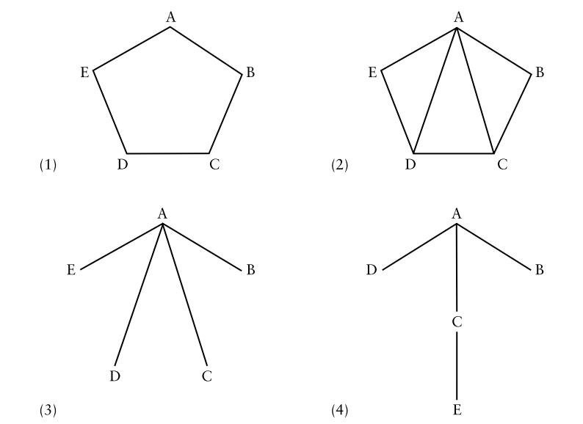
Networks

Slide 26
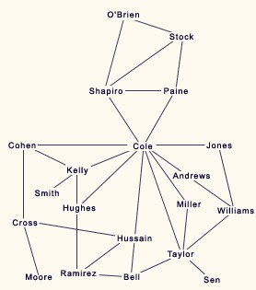
Networks
Dense = if you know and interact with people who also know and interact with the same people (all people in your network are connected)
If not, then Loose
Multiplex = if people in the network are tied to each other in multiple ways (you work, live with, hang out with your brother/sister)
Social networks connected to social class (James and Leslie Milroy)
Discuss Milroy & Milroy, 1992

Slide 27
We . . . suggest the term speech repertoire for the repertoire of linguistic varieties utilized by a speech community which its speakers, as members of the community, may appropriately use, and the term verbal repertoire for the linguistic varieties which are at a particular speaker’s disposal.

